Slide 1


Code The Cloud:
CCD Edition Hackathon
Team name: Ajit kumar singh and Pramod kumar singh
Title :CloudPay 360
Cloud मुंबई

Slide 2


Chapter One
Slide 2: Agenda
Title: Agenda
Content:
Project Overview
Architecture & Impact
Real-Time Transaction Metrics
Transaction Overview
Fraud Alerts
Process Payment
Platform Settings
Current Status & Roadmap
Contact & Team

Slide 3

Chapter Two
Project Overview
Title: Project Overview
Content:
Problem Statement: Fragmented payment systems lead to integration complexity, scalability issues, and poor visibility, costing businesses time and revenue.
Solution: CloudPay 360 offers a single, secure API to simplify payments and enable global scaling.
Cloud-Native Features:
Real-time fraud detection and predictive analytics via AWS Lambda.
Scalable infrastructure with Docker and Terraform.
Multi-currency support for global reach.
Tech Stack:
Backend: Java, Spring Boot, PostgreSQL, Redis
Frontend: React
Cloud: AWS (Lambda, API Gateway, DynamoDB), Terraform, Docker
Messaging: Kafka
.

Slide 4

Chapter Three
Architecture & Impact
Title: Architecture & Impact
Content:
High-Level Architecture:
Flow: User → API Gateway → Services (Auth, Payment Orchestrator, Fraud Detection) → DB/Kafka → Dashboard
Key Benefits:
Secure and PCI-DSS compliant.
Fast integration with a single API.
Real-time transaction visibility.
Target Users: E-commerce platforms (e.g., Shopify) needing multi-currency support.

Slide 5

Chapter Four
Real-Time Transaction Metrics
Title: Real-Time Transaction Metrics
Content:
Total Transactions: 9,010
Failed Transactions: 20
Fraud Suspected: 12
Breakdown:
Card Transactions: 4,520
UPI Transactions: 2,720
Wallet Transactions: 1,360
Other Transactions: 410

Slide 6
Chapter Five
Transaction Overview
Title: Transaction Overview
Content:
Recent Transactions (from Image 3):
TXN_001 | MERCH_123 | 100.00 USD | UPI | Primary | Matched | Successful
TXN_002 | MERCH_456 | 50.00 EUR | SWIFT | Fallback | Pending | Pending
TXN_003 | MERCH_789 | 75.00 INR | NEFT | Primary | Unmatched | Failed
Latest Update: New transaction detected: TXN_174960497942

Slide 7
Chapter six
Fraud Alerts
Title: Fraud Alerts
Content:
High Risk Transaction: Unusual location (Risk Score: 85%)
Suspicious Activity: Multiple attempts (Risk Score: 90%)
Potential Fraud: Unverified merchant (Risk Score: 80%)

Slide 8
Chapter seven
Process Payment
Title: Process Payment
Content:
Merchant ID: e.g., MERCH_123
Amount: Enter Amount
Currency: USD
Payment Method: UPI
Customer ID: e.g., CUST_456
Invoice ID: Optional

Slide 9
Chapter eight
Platform Settings
Title: Platform Settings
Content:
Merchant Name: e.g., ABC Store
API Key: e.g., sk_123456789
Cloud Provider: AWS
Compliance: PCI-DSS, ISO 27001, GDPR
Enabled Features:
AML Screening
Fraud Detection

Slide 10
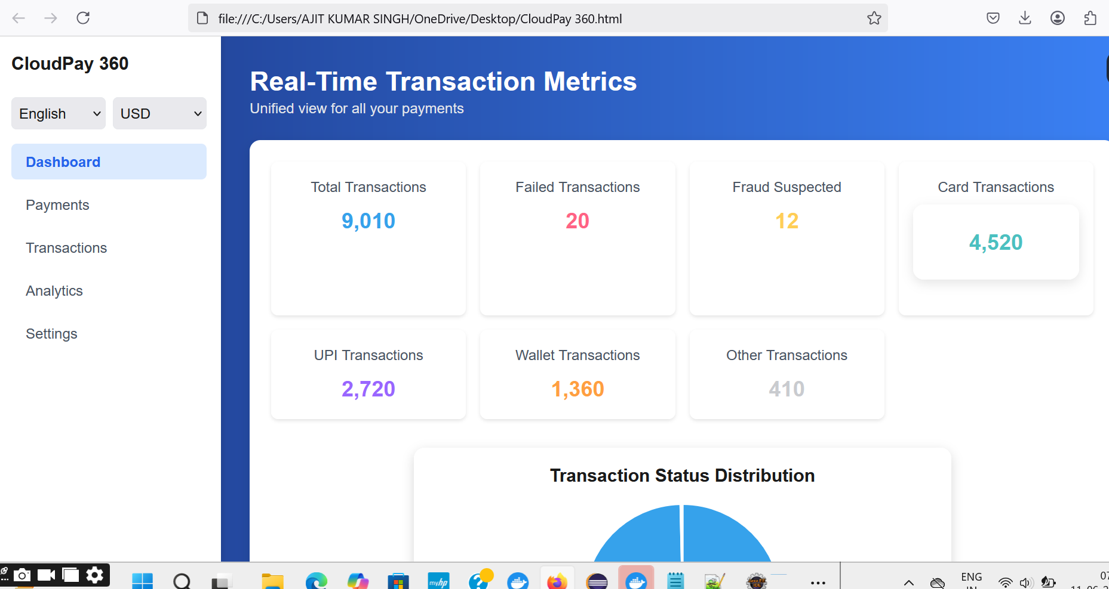
Chapter nine

Slide 11
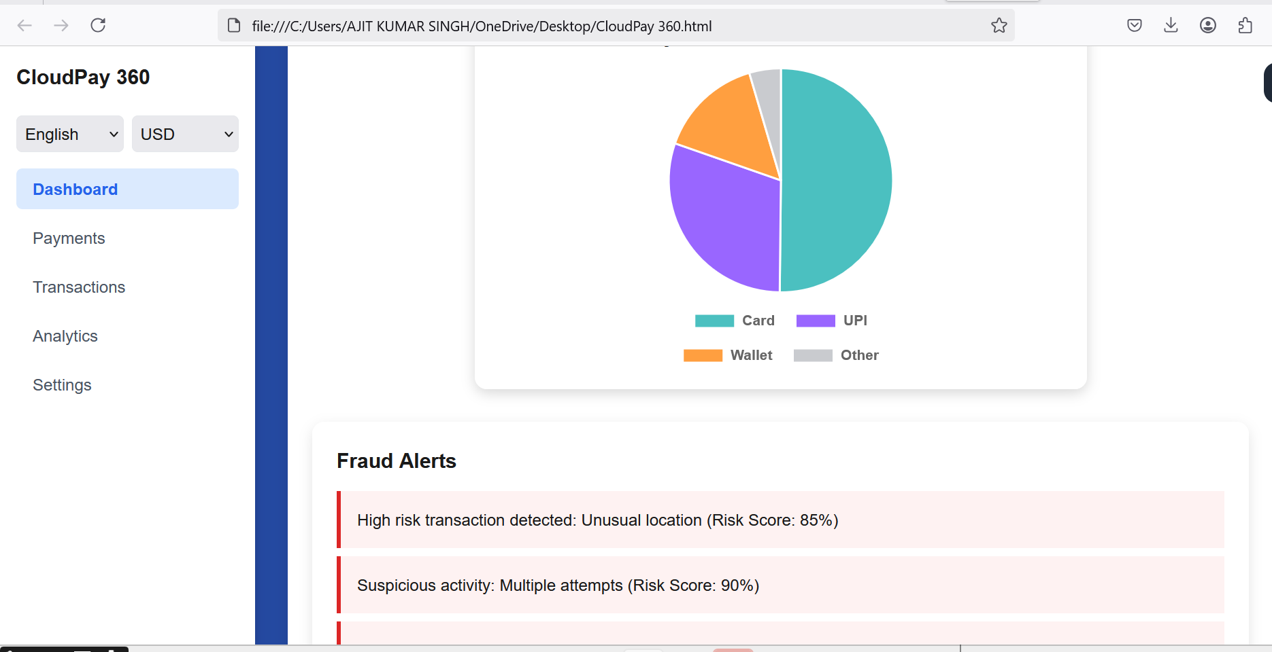
Chapter Ten

Slide 12
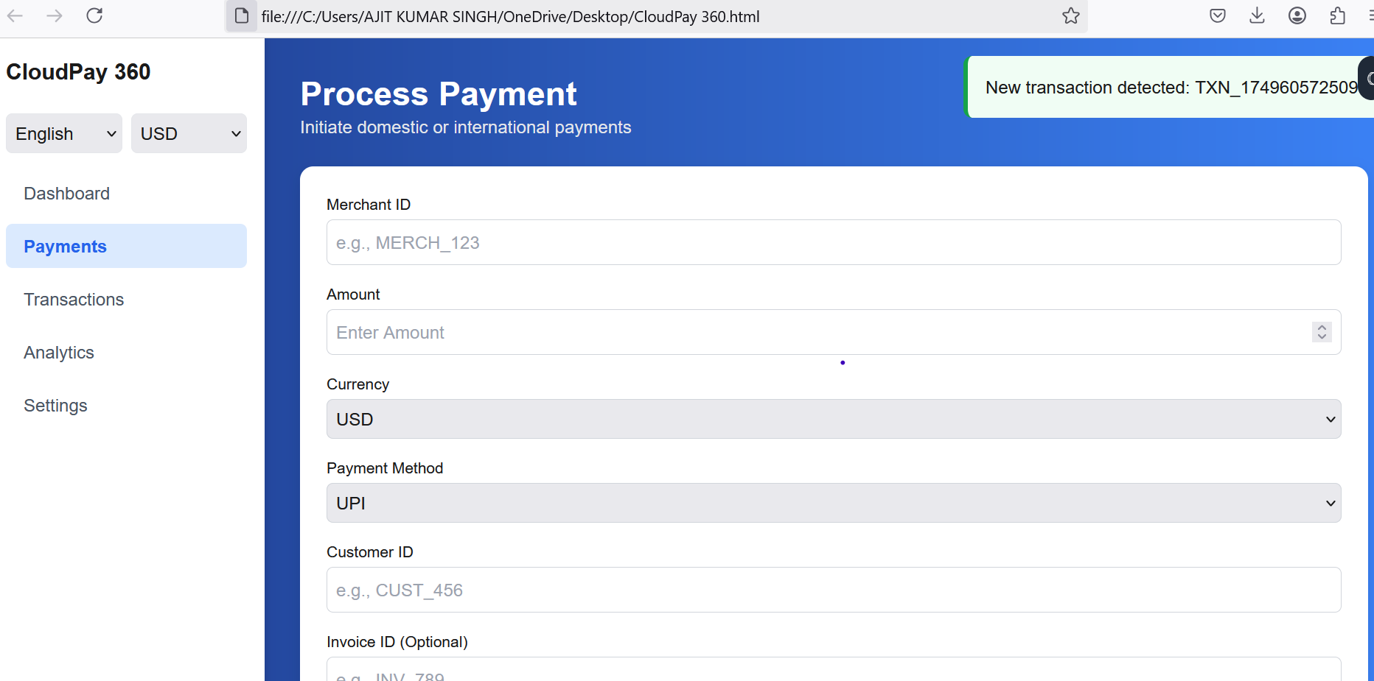
Chapter eleven

Slide 13
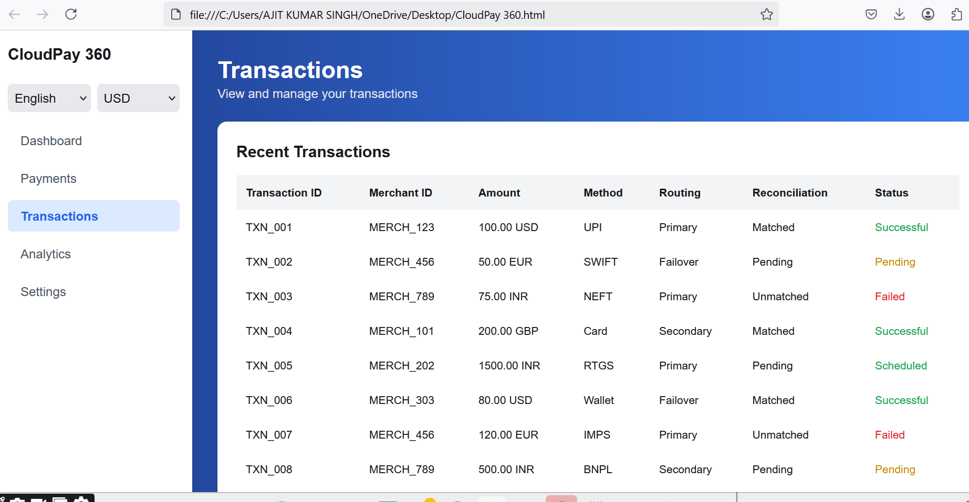
Chapter twelve

Slide 14
Chapter Thirteen

Slide 15
Chapter Thirteen

